Slide 1

Information Technology and Business

Slide 2
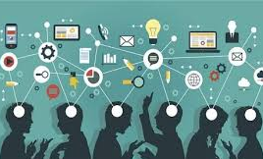
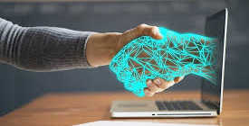
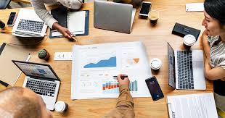
info:
facts, data or the
communication
reception of knowledge
or intelligence
tech:
human knowledge
branch of knowledge
deals with the creations
business:
activity engaged in as a
means of livelihood

Slide 3
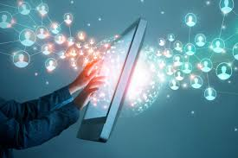
Introduction
is designed to provide students with expertise
help develop and use of computer systems with quantitative modeling
techniques of solving business problems and making managerial decisions

Slide 4
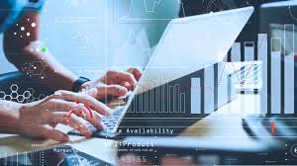
Business in the information age
transforms companies - economies – societies (uplift)
constitute the great business challenge
such as electronic books, videos, gaming &social networking etc. are delivered
are expressions of this transformation, which centers around processes and info systems

Slide 5
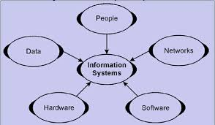
Information Systems
set of components for collecting, storing and processing data
carry out and manage their operations
interact with the customers as well as suppliers
ex: invention of printing press - Johannes
invention of mechanical calculator- Pascal

Slide 6
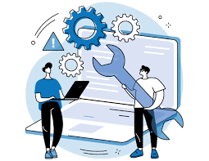
Organizational structure
System that outlines
Activities are directed in order to achieve the goals of the organization
determines how information flows between levels within the company
Example : a centralized structure , decisions flow from the top down

Slide 7
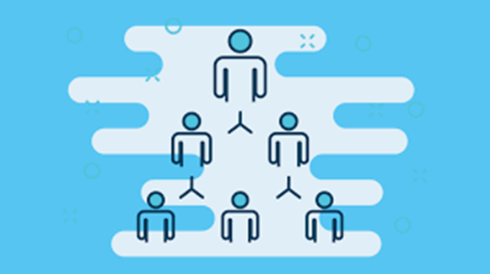
IT Support
Computer networks of all types of organizations
provide technical support run smoothly
Support monitors
maintains the company computer system

Slide 8
Evolution of Information System
1st introduced in 1960 to deal with accounting management issues
use in the previous years as Computers Strives to evolve
has made significant progress over the past 50 years
newest technique doesn’t immediately replace older models
performs repetitive ,high-volume and Transaction –computing task
punch card,electronic calculator has evolved today to e commercialism,mobile computing

Slide 9
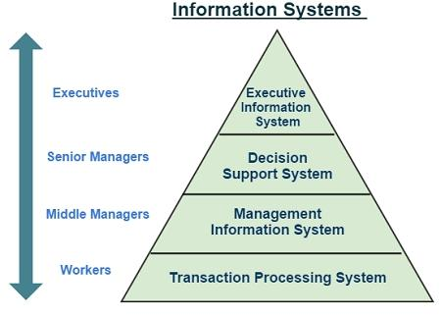
Types of Information System

Slide 10
1.Transactions Processing System(TPS)
collects,stores,modifies and retrieves the data tranascations of an enterprise
supports the operational level of the business that supplies data for higher level management decision
focus on record keeping And control of repetitive clerical processes
examples of TPS includes,system used for billing in department stores,ATM operations,etc

Slide 11
2. Management Information System (MIS)
processing data into information and providing information to managers
helps to manage an organisation effectively
used by middle level managers
should have clearly defined framework,guidelines, plan and policies,standard and procedures to meet the strategic goals
examples of MIS includes an annual budgeting.

Slide 12
3.Decision Support System(DSS)
collects and reports certainly types of data types,which can help managers make better decisions
flexible,adaptable and quick
helps to make decisions by working and analysing data
supports for improving quality of manager’s decision rather than replacing a manager’s judgement
provides required information to support decision making process.

Slide 13
4.Executive Support System(ESS)
also known as Executive Information System
provides rapid access to timely information and direct access to management reports
used by top level management
designed to the individuals executives
very expensive to run and require extensive staff of works to operate.

Slide 14
IT for business
are the complete set that are cannot been separated
use of computers and software to manage information
also used for storing, protecting, processing, securing, transmitting, receiving, and retrieving information.
Roles of IT in business are:-
Helping the company be more productive, in terms of time and money
Optimizing business performance
Enhancing managerial decision-making
Providing staff access to company information

Slide 15
IT for individual
In today’s 21st century information technology is the part of our daily life
used for learning, entertainment, communication, to collect news, to play games, etc
Roles of IT for individuals are:-
For studying
To communicate with family and friends
To transfer documents and files
To explore the world

Slide 16
Computers in past and present
In the 1940s, computers were just starting to be popular in businesses
Computers were the size of a room.
Vacuum tubes and transistors were used in computers.
were expensive and normal can’t afford it.
used to have small computers on desk or tablets.
are cheaper and can be afford by anyone.
used for many purpose.

